Slide 1
CHAPTER - 4
Operators and Expressions
Presented by Henil Patel

Slide 2
C Operators and Expressions: An Overview
C supports a rich set of built-in operators that perform mathematical or logical manipulations. These operators are fundamental to forming expressions, which are sequences of operands and operators that reduce to a single value.
C Operators are Classified into Categories:
Arithmetic
Relational & Logical
Assignment
Increment/Decrement
Conditional & Bitwise
Special Operators
Notes:
1

Slide 3
Arithmetic Operators
Basic Arithmetic Operators
Understanding Arithmetic Operations
Arithmetic operators are symbols that tell the C compiler to perform specific mathematical calculations on operands, such as addition, subtraction, multiplication, and division. They are fundamental for numerical computation in programs.
+
Addition or unary plus
-
Subtraction or unary minus
*
Multiplication
Key Characteristics:
/
Division (Integer division truncates fractional part)
Binary Operators: Most arithmetic operators (+, -, *, /, %) are binary, meaning they operate on two operands.
%
Modulo division (remainder)
Unary Operators: The plus (+) and minus (-) signs can also act as unary operators, indicating positive or negative values (e.g., -5).
Note: C does not have an operator for exponentiation. Modulo division (%) cannot be used on floating-point data.
Notes:
2

Slide 4
Integer Arithmetic
Definition and Characteristics
Integer arithmetic refers to operations performed on whole numbers (integers) in C. These operations include addition (+), subtraction (-), multiplication (*), division (/), and modulo (%). A key characteristic is that the result of any integer arithmetic operation will always be an integer. This implies that any fractional part generated during division is discarded.
Integer Division and Truncation
One of the most important aspects of integer arithmetic in C is how division operates. When you divide two integers, the result is an integer, and any fractional part is truncated (cut off) towards zero. This is not the same as rounding.
Consider the following examples:
7 / 3 results in 2 (the actual value is 2.33..., truncated to 2).
-7 / 3 results in -2 (the actual value is -2.33..., truncated to -2).
7 / -3 results in -2 (the actual value is -2.33..., truncated to -2).
-7 / -3 results in 2 (the actual value is 2.33..., truncated to 2).
The modulo operator (%) provides the remainder of an integer division. The sign of the result of a modulo operation matches the sign of the dividend (the first operand). For example, 7 % 3 is 1, and -7 % 3 is -1.
Notes:
This card provides a comprehensive overview of integer arithmetic in C.
Explains the definition and characteristics of integer operations.
Details integer division's truncation behavior with examples.
Highlights key considerations like division by zero and type promotion.
Includes a complete C program demonstrating various integer arithmetic operations.
Provides and explains the expected output of the C program.
3

Slide 5

Real and Mixed-Mode Arithmetic
Real Arithmetic
Involves only real (floating-point) operands. The result is an approximation due to rounding of significant digits.
Example: 6.0 / 7.0 = 0.857143
The % operator cannot be used with real operands.
Mixed-Mode Arithmetic
Involves one real and one integer operand. The operation performed is always a real operation, and the result is a real number.
Example: 15 / 10.0 = 1.5 (vs. 15 / 10 = 1)
Notes:
4

Slide 6
Relational Operators: Making Comparisons
Relational operators compare two quantities, forming a relational expression that yields a value of one (true) or zero (false).
Operator
Meaning
Relational Operator Complements
Each operator has a complement, which can simplify expressions involving the ! (not) operator.
<
is less than
<=
is less than or equal to
!(x < y)
>
is greater than
is equivalent to x >= y
>=
is greater than or equal to
!(x == y)
==
is equal to
is equivalent to x != y
!=
is not equal to
Priority: Arithmetic operators are evaluated before relational operators.
Notes:
5

Slide 7



Logical Operators
Logical operators combine two or more relational expressions into a logical expression, also yielding a value of one (true) or zero (false).
Logical AND (&&)
Logical OR (||)
Logical NOT (!)
True only if both relational expressions are true.
True if at least one relational expression is true.
Reverses the truth value of an expression.
Example: if (age > 55 && salary < 1000)
This is true only if both conditions are met.
Notes:
6

Slide 8

Assignment Operators
C provides shorthand assignment operators (op=) to simplify the assignment of an expression result back to the original variable.
The form v op= exp; is equivalent to v = v op (exp); Where v is variable, exp is an expression and op is a c binary arithmatic operator.
Common Shorthand Operators
Advantages
a += 1
Equivalent to a = a + 1
Easier to write (variable not repeated).
a -= 1
Equivalent to a = a - 1
More concise and readable statement.
a *= (n+1)
Equivalent to a = a * (n+1)
a /= (n+1)
Equivalent to a = a / (n+1)
More efficient execution.
a %= b
Equivalent to a = a % b
Notes:
7

Slide 9


Increment and Decrement Operators (++, --)
These unary operators add or subtract 1 from the operand. Their placement (prefix or postfix) affects when the operation occurs within an expression.
Prefix (++m)
The variable is incremented/decremented first, then the new value is used in the expression.
Example: y = ++m; (m increments, then y gets new m)
Postfix (m++)
The original value is used in the expression first, then the variable is incremented/decremented.
Example: y = m++; (y gets old m, then m increments)
The conditional operator (?:) is a ternary operator used to construct conditional expressions: exp1 ? exp2 : exp3. If exp1 is true, exp2 is evaluated; otherwise, exp3 is evaluated.
Notes:
8

Slide 10
Special Operators: Bitwise, Comma, and sizeof
Bitwise Operators
The Comma Operator
The sizeof Operator
Used for manipulation of data at the bit level (testing or shifting bits). Cannot be applied to float or double.
Links related expressions together. Expressions are evaluated left to right, and the value of the right-most expression is the value of the combined expression.
A compile-time operator that returns the number of bytes the operand occupies (variable, constant, or data type).
& (AND)
Used to determine the size of arrays/structures or for dynamic memory allocation.
| (OR)
Example: value = (x=10, y=5, x+y); (value becomes 15)
^ (XOR)
<< (Shift Left)
Example: m = sizeof(sum);
> (Shift Right)
Notes:
9

Slide 11
Precedence of Arithmetic Operators
In C programming, just like in mathematics, operator precedence dictates the order in which operations are performed in an expression. When an expression contains multiple operators, those with higher precedence are evaluated before those with lower precedence.
How Precedence Affects Evaluation
Consider the following example:
int result = 5 + 3 * 2;
Without understanding precedence, one might incorrectly assume that 5 + 3 is evaluated first. However, because multiplication (*) has higher precedence than addition (+), the expression is evaluated as follows:
// Step 1: Multiplication is performed firstresult = 5 + (3 * 2); // result = 5 + 6;// Step 2: Addition is performed nextresult = 11;
Notes:
10

Slide 12
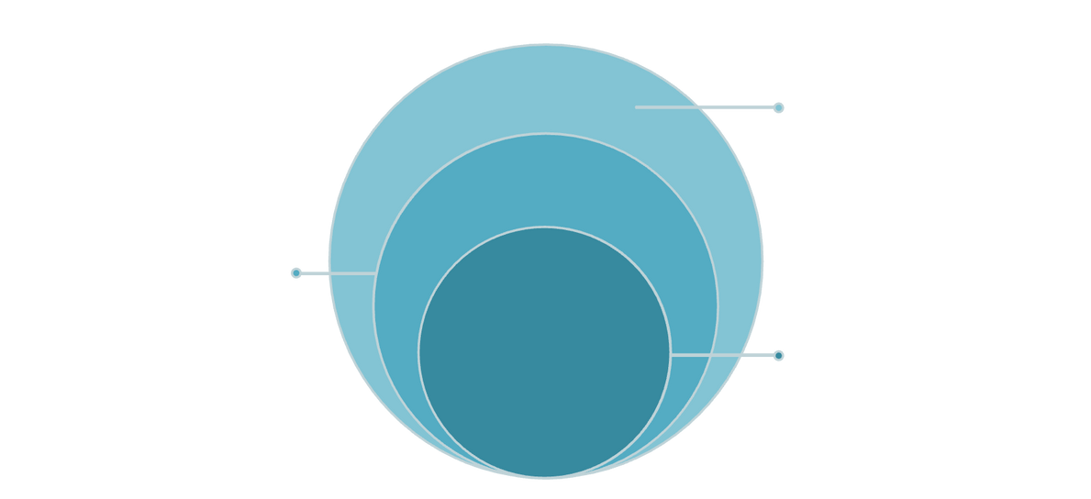
Type Conversions in Expressions
C handles mixed-type expressions through automatic (implicit) and forced (explicit) type conversions.
Outer
float → double → long double
Middle
int → unsigned int → long int → unsigned long int
Core
char / short
Implicit Conversion
Explicit Conversion (Casting)
The 'lower' type is automatically converted to the 'higher' type before operation. The result is of the higher type.
Forces a local type conversion using the form (type-name) expression.
Example: ratio = (float) female_number / male_number;
Notes:
11

Slide 13


Operator Precedence and Associativity
These rules determine the order of evaluation in complex expressions.
1
2
3
Precedence
Associativity
Parentheses
Decides the order in which different operators are applied (e.g., multiplication before addition).
Decides the order when multiple operators have the same precedence (e.g., left-to-right for arithmetic).
Expressions within parentheses assume the highest priority, overriding standard precedence rules.
Mathematical functions (like cos, sqrt, log) are available by including the math.h header file.
Notes:
12

Slide 14

Thank You
Thank you for your attention.
Notes:
13

